Slide 1

Question Pairs
Sukanya Behera [160714733008]
Chandrabhatta Sriram [160713733042]
Abul Faiz Mohammed Abdul Hadi Mouzzam [160714733108]
Project Guide: E. Shailaja [Asst. Prof. Dept. of CSE]
Project Co-ordinator: R. Sandeep [Asst. Prof. Dept. of CSE]
Methodist College of Engineering & Technology

Slide 2
Introduction [Problem Definition]
More formally, the duplicate question detection problem can be defined as follows: given a pair of questions q1 and q2, train a model that learns the function:
f(q1, q2) → 0 or 1.
where 1 represents that q1 and q2 have the same intent and 0 otherwise.
NOTE: q1 and q2 are given as string data.

Slide 3
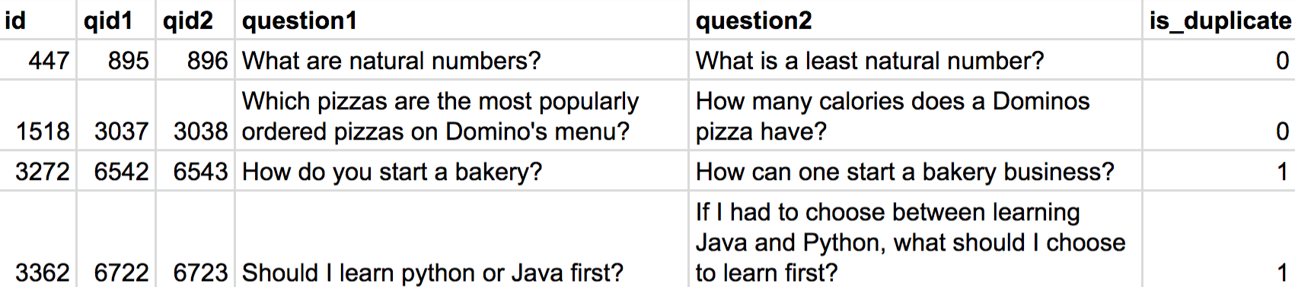
Problem Input [test.csv]

Slide 4
Problem Output [Expected]

Slide 5
Modules
Text Pre-processing: text tokenization, uniform text casing, stop word removal, lemmatization, stemming, etc.
Featurization / Vectorization of the texts [q1 and q2]: Convert the given q1 and q2 into Word Vectors using word2vec. Word vectors are positioned in the vector space such that words that share common contexts in the corpus are located in close proximity to one another in the space.
Apply a Machine Learning Model [using k – Nearest Neighbours algorithm] to get the Expected Output.

Slide 6
Data Flow Diagram – Level 0

Slide 7
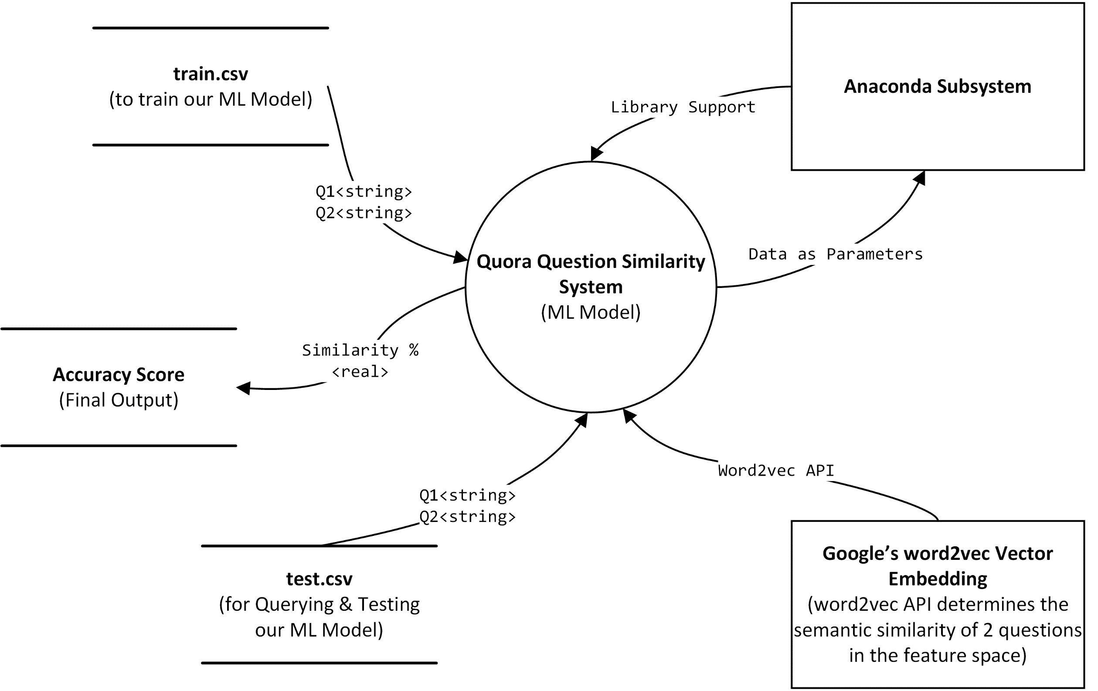

Slide 8
Data Flow Diagram – Level 1 Quora Question Similarity System

Slide 9
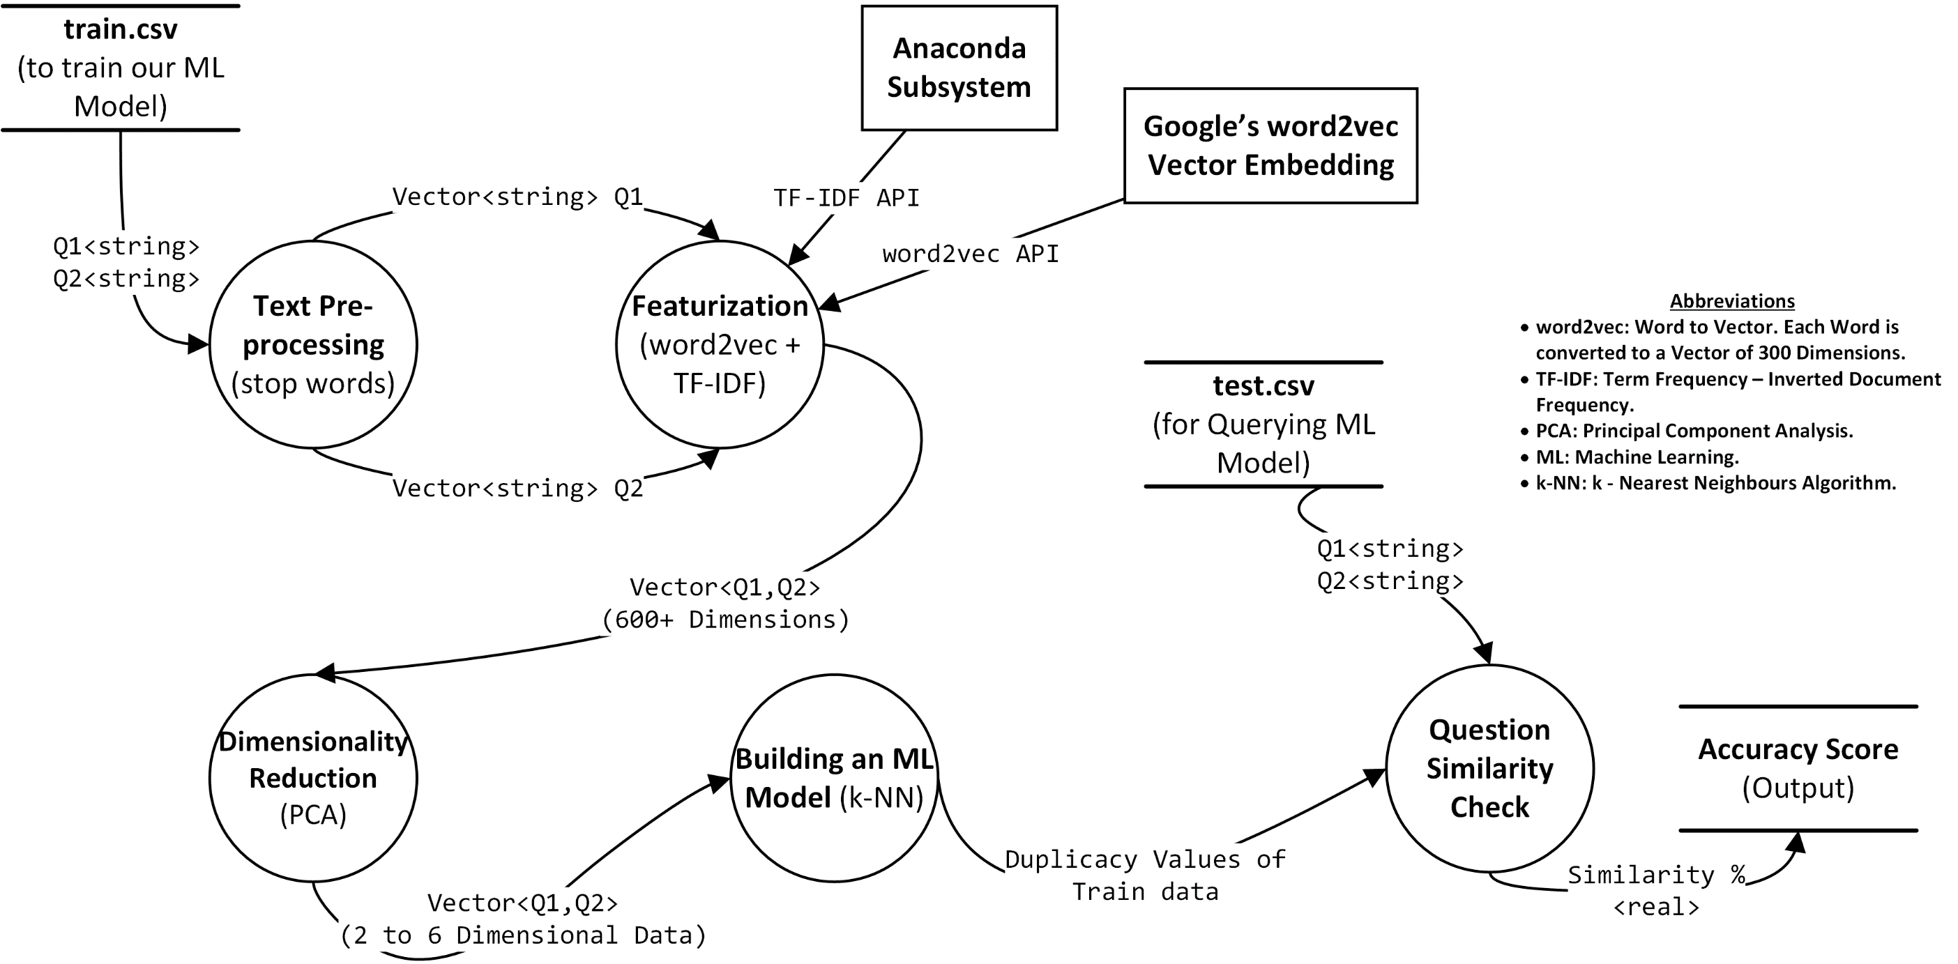

Slide 10
Use Case Diagram – 1 [Question Posting]

Slide 11
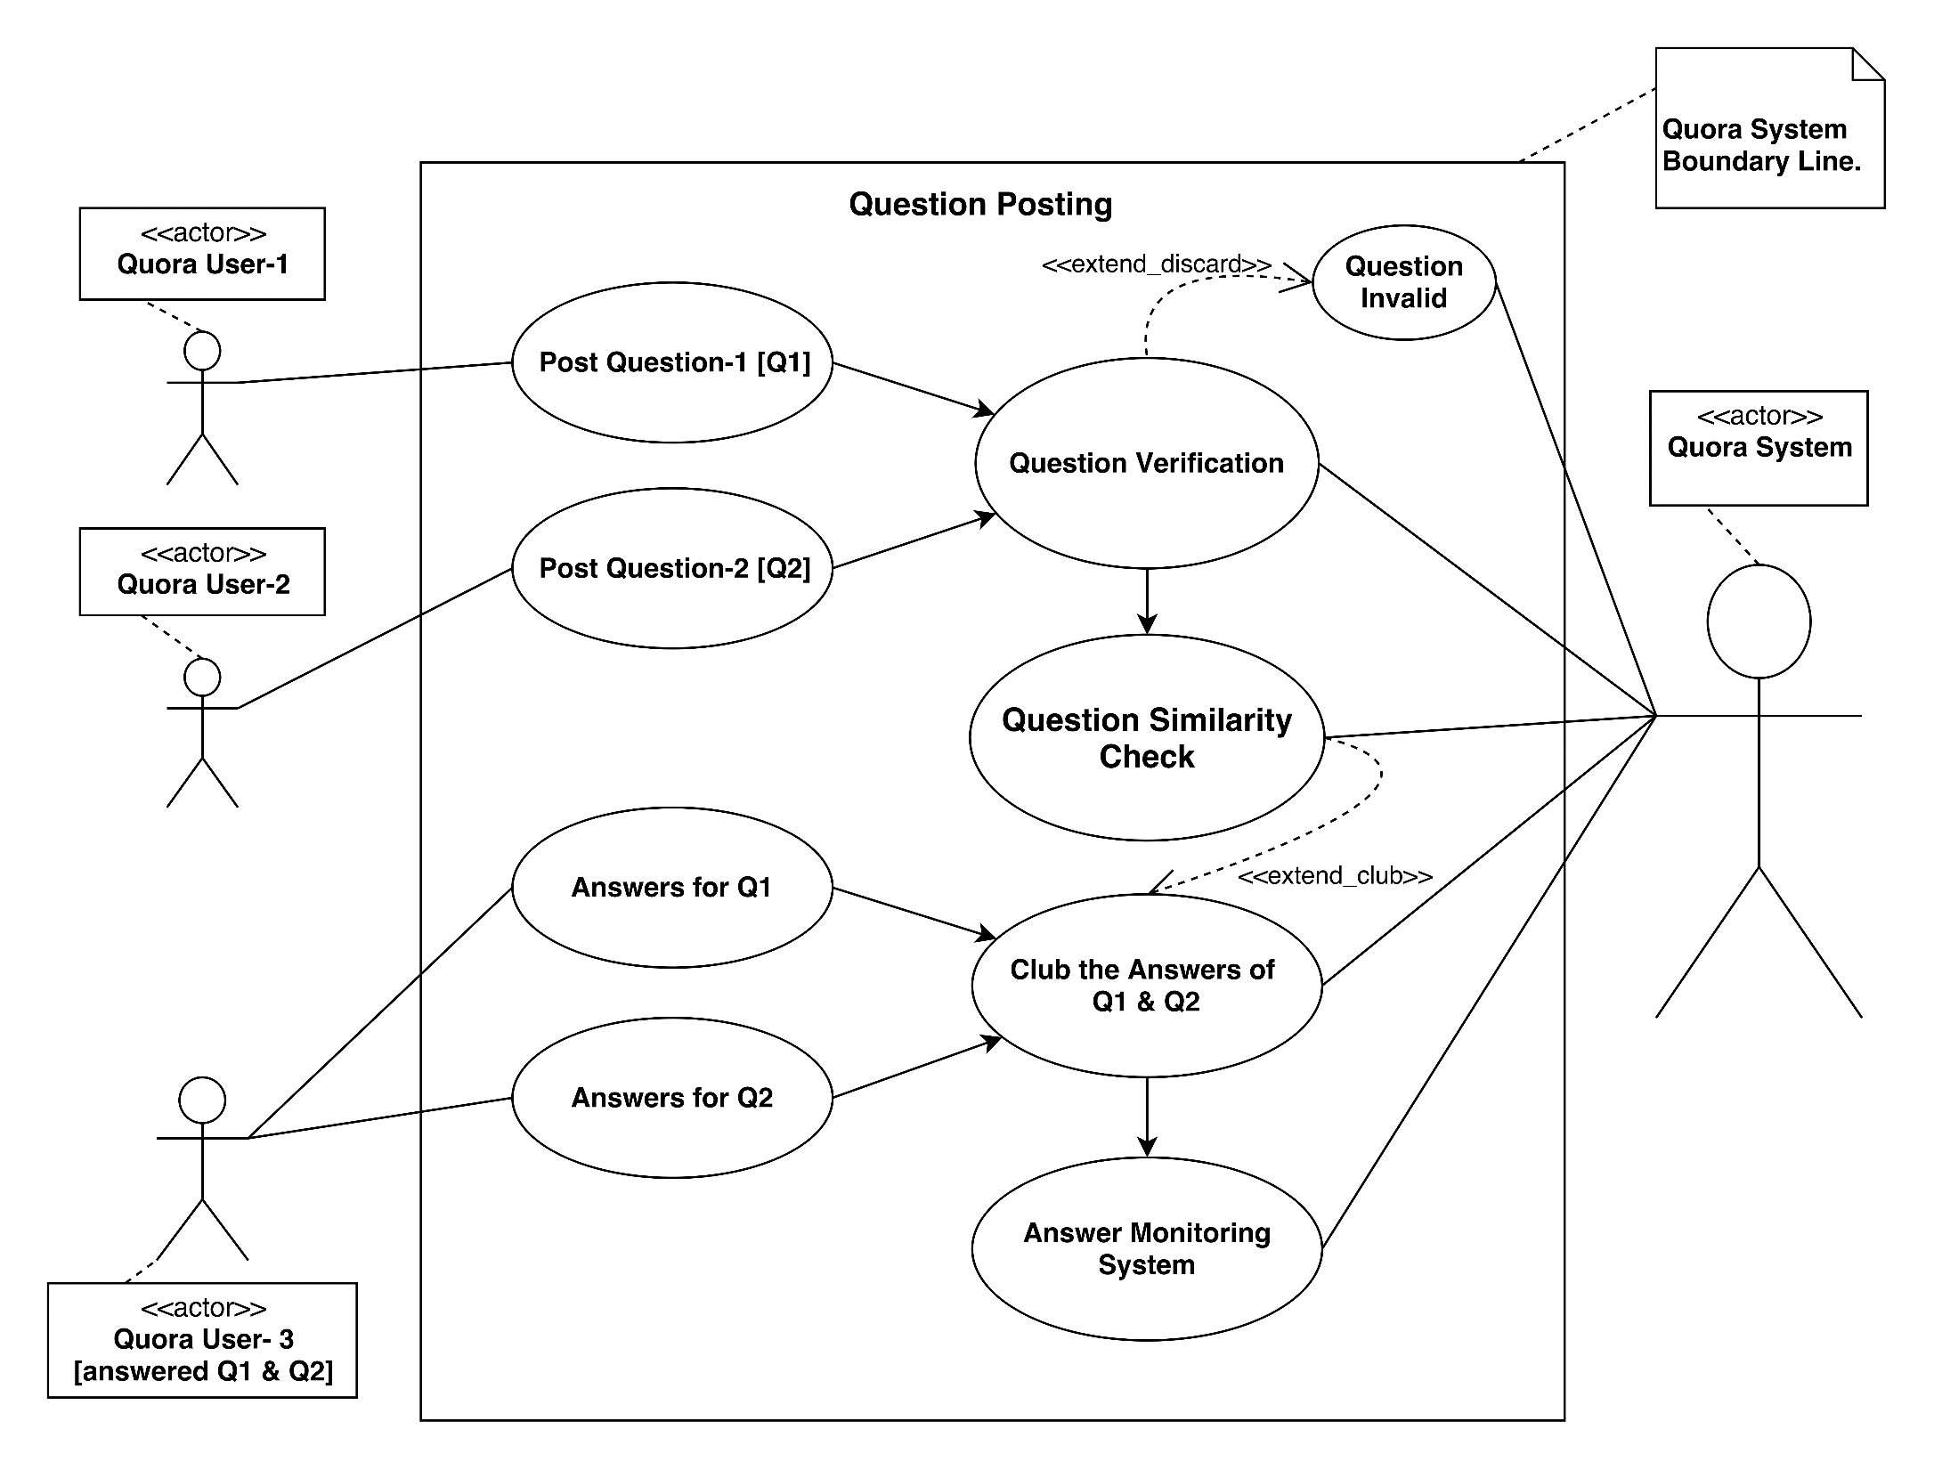

Slide 12
Use Case Diagram – 2 [Question Search]

Slide 13
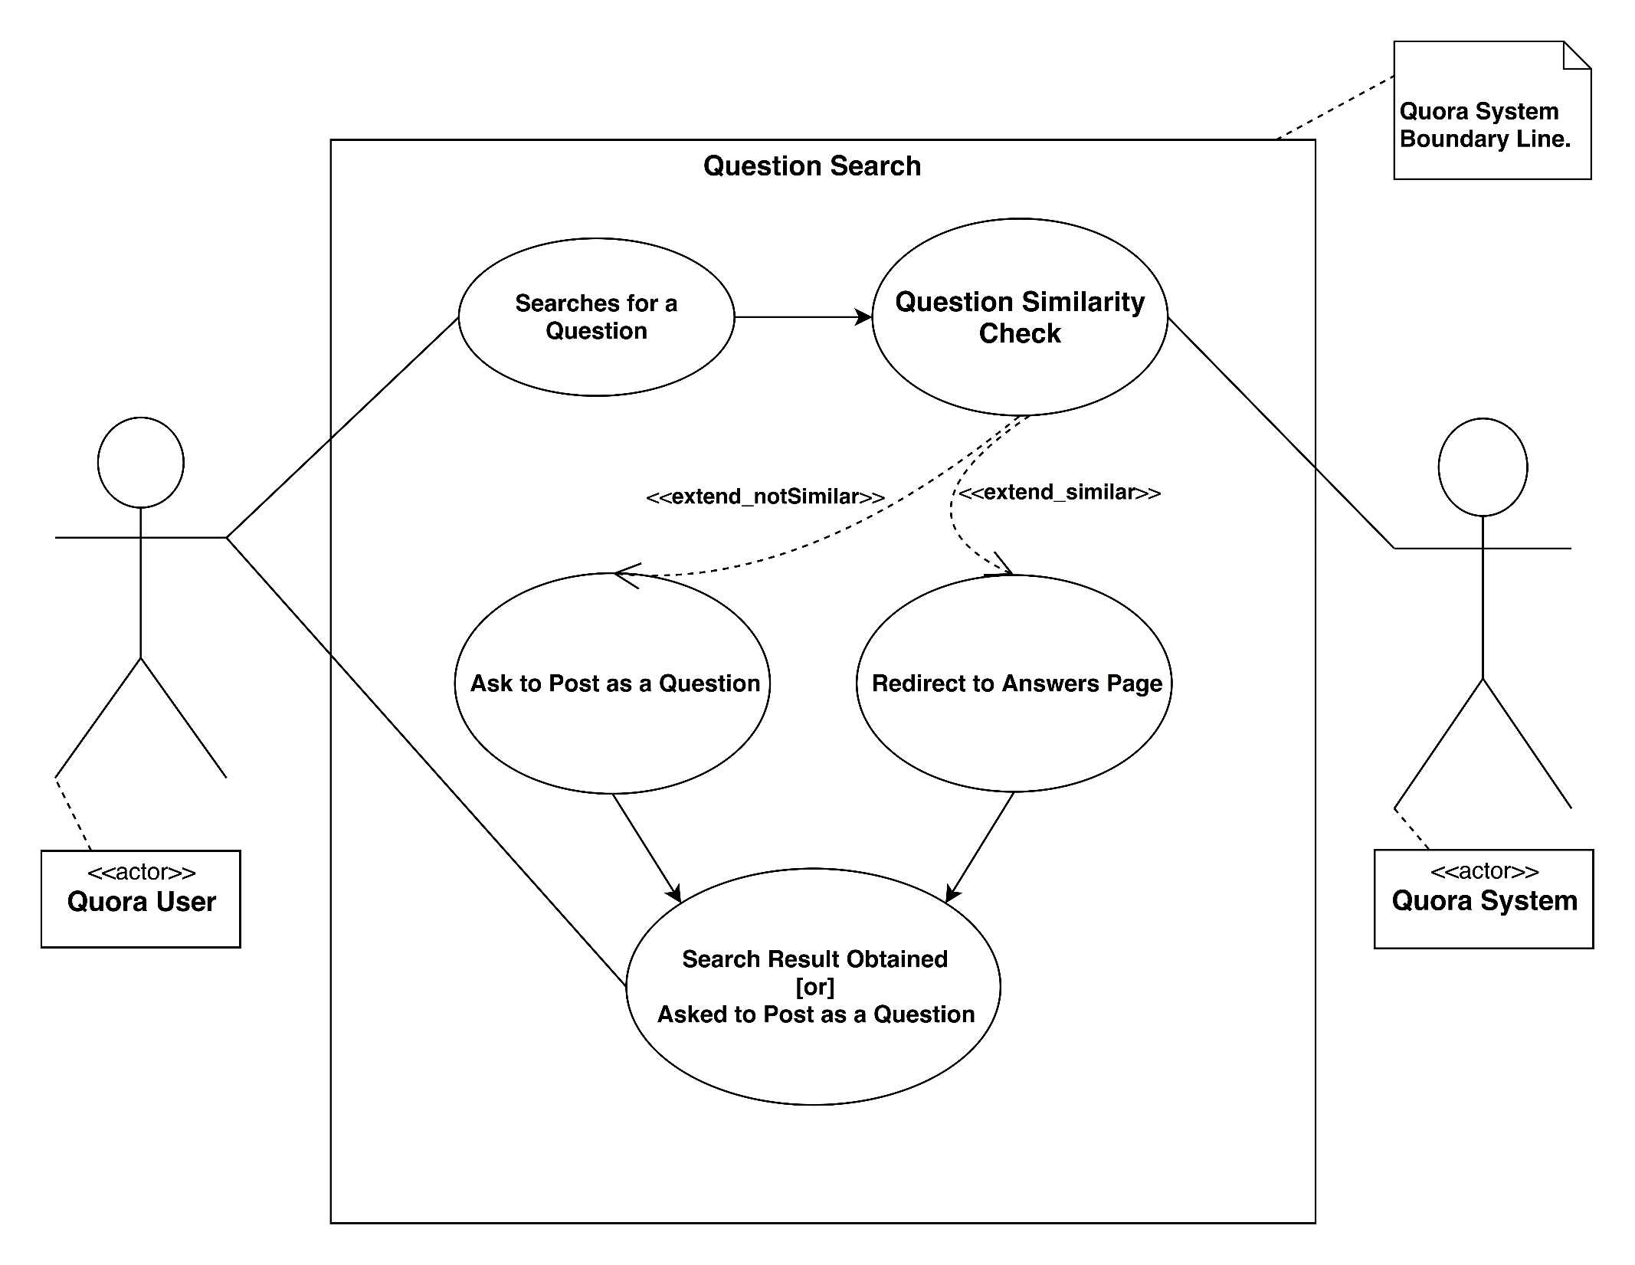

Slide 14
Sequence Diagram

Slide 15
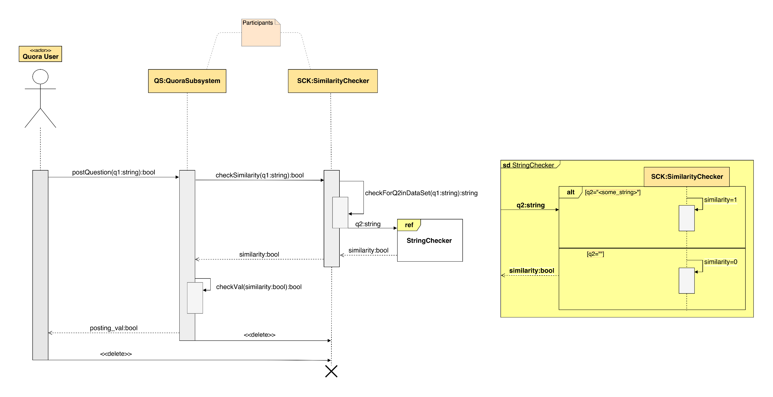

Slide 16
Deployment Diagram

Slide 17
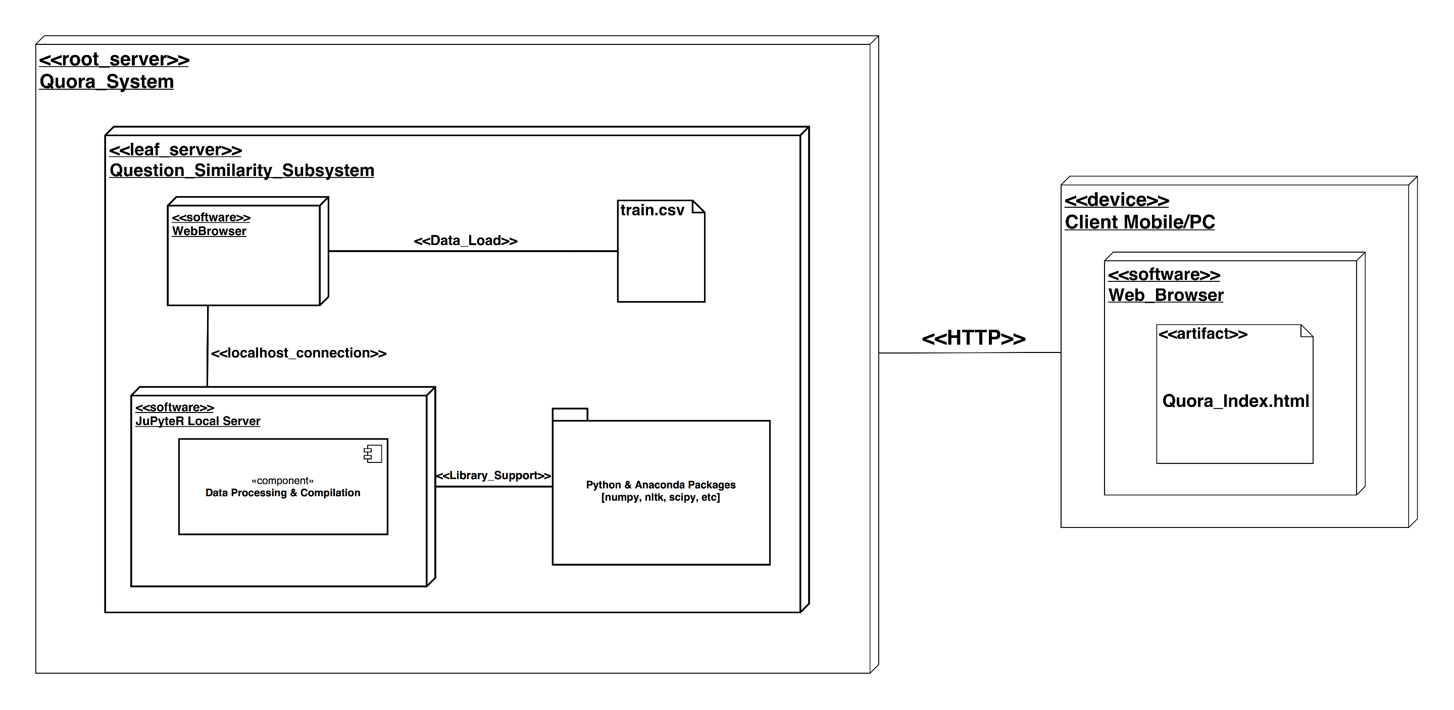

Slide 18
Algorithm Information
In k-NN classification, the output is a class membership. An object is classified by a majority vote of its neighbours, with the object being assigned to the class most common among its k nearest neighbours (k is a positive integer, typically small). If k = 1, then the object is simply assigned to the class of that single nearest neighbour.
Distance between 2 points in the feature space, can be found by taking Euclidean Distance (L² Norm) between those 2 points.

Slide 19
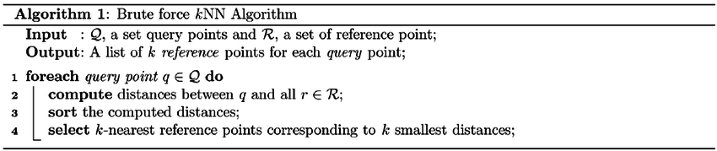
k-NN Brute Force Pseudo Code
Complexity: O (mnd), which makes it a Polynomial Time Algorithm.

Slide 20
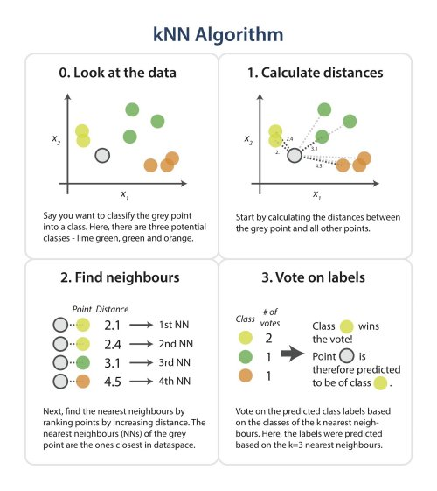

Slide 21
KD-Tree Algorithm for k-NN
function kdtree (list of points pointList, int depth)
{
// Select axis based on depth so that axis cycles through all valid values
var int axis := depth mod k;
// Sort point list and choose median as pivot element
select median by axis from pointList;
// Create node and construct subtree
node.location := median;
node.leftChild := kdtree(points in pointList before median, depth+1);
node.rightChild := kdtree(points in pointList after median, depth+1);
return node;
}

Slide 22
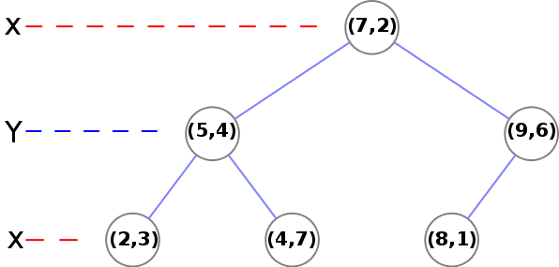
KD-Tree Visualization for k-NN

Slide 23
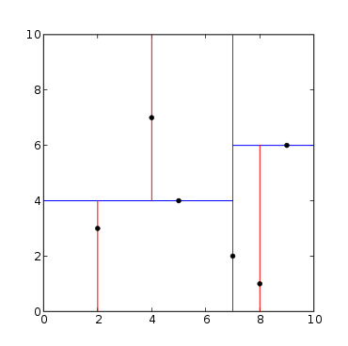
k-d tree decomposition for the point set (2,3), (5,4), (9,6), (4,7), (8,1), (7,2).

Slide 24
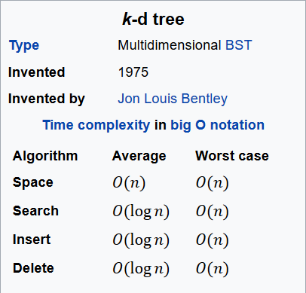
KD-Tree Algorithm Details

Slide 25
Software & Hardware Requirements
Software Requirements
OS: Windows 7/8/10, Linux (Cent/Ubuntu).
Packages: Python 3.6, Anaconda Package for Data Science & Machine Learning.
Hardware Requirements:
Minimum System Requirements:
8GB RAM, 5GB Disk Space, 1GHz Processor.
Recommended System Requirements:
16GB RAM, 15GB Disk Space, 3.5GHz Multi Core Processor.

Slide 26
Code Snippets

Slide 27
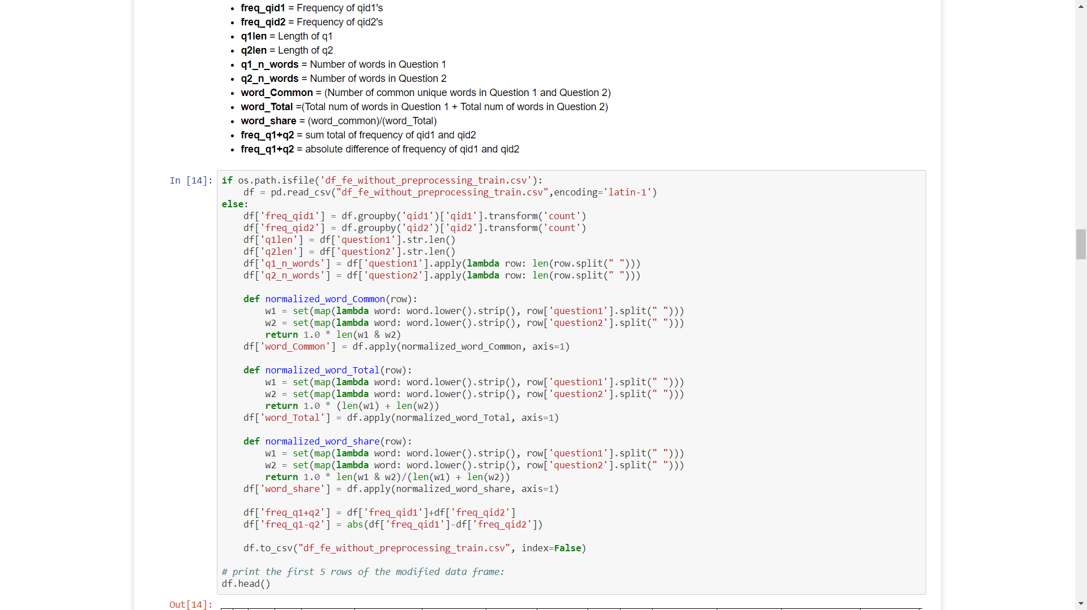

Slide 28
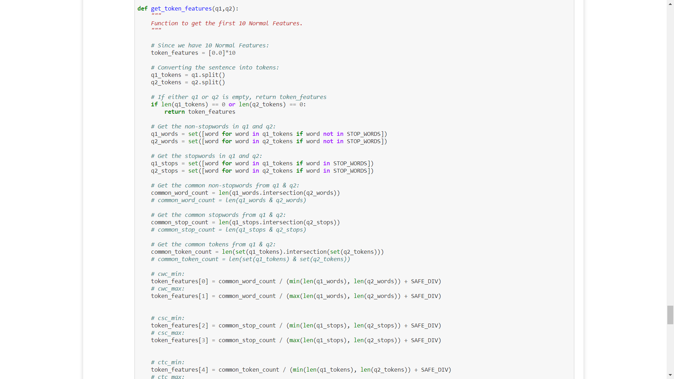

Slide 29
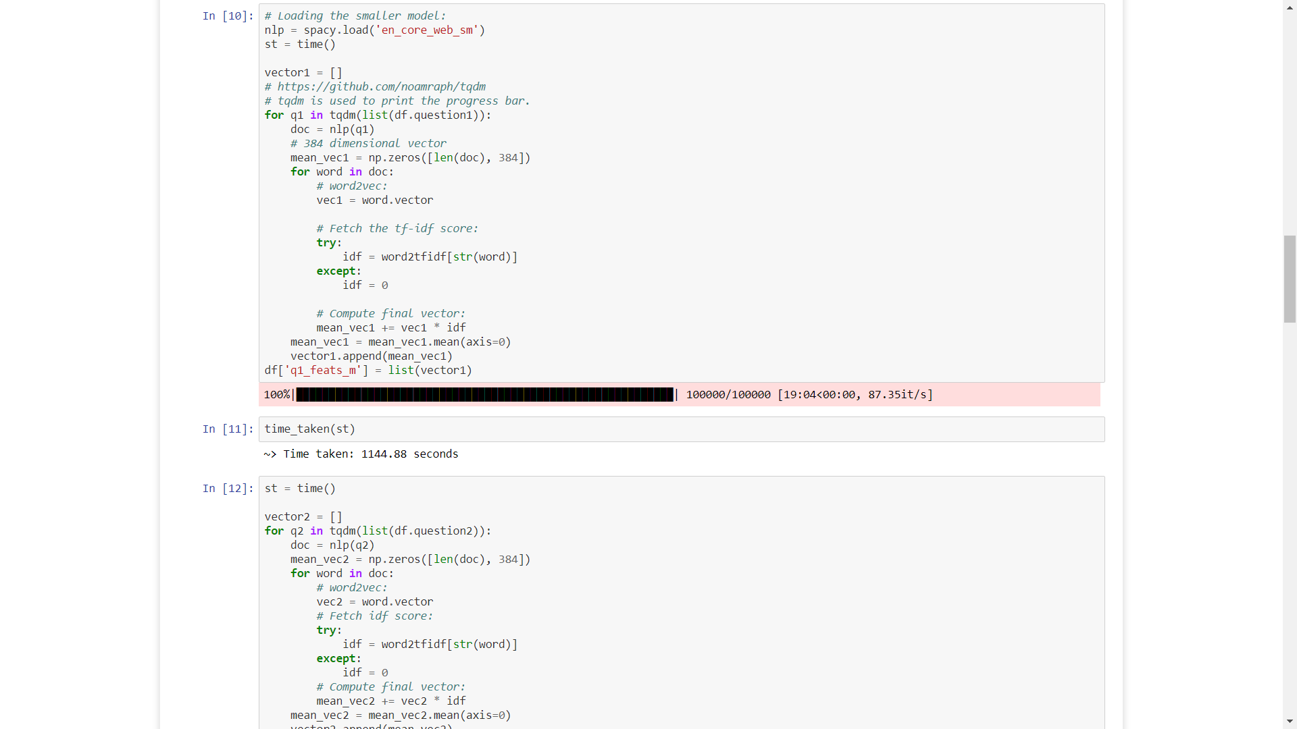

Slide 30
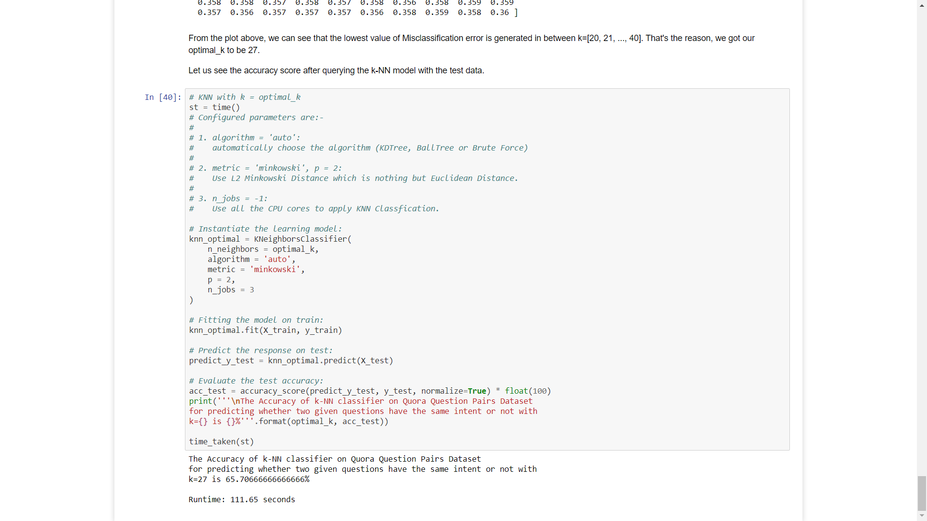

Slide 31
Conclusion
Successfully applied k-Nearest Neighbours Algorithm on the Quora Question Pair Similarity Dataset as two variants:
k-NN after Simple Cross Validation [Train-Test Split: 70-30 of 25k Sampled Data Points]
k-NN after K-fold Cross Validation [Here, ‘K’ is not the same ‘k’ in k-NN].
The Accuracy of k-NN classifier on a sample of 25,000 Data Points of Quora Question Pairs Dataset for predicting whether two given questions have the same intent or not with k=27 is 65.70666666666666%.
Due to a computational discrepancy, only 25k Data Points were taken. But, if we apply the same algorithm on the entire Dataset, the Accuracy Score will be near to ~90%.

Slide 32
Thank You!

Slide 33
Any Questions/Queries?

